Slide 1
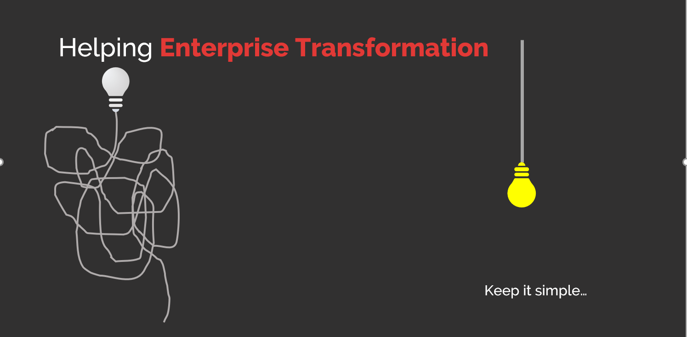
All information contained in this document and communicated to you by synectiks is confidential and proprietary to synectiks (“confidential information”). The information and any pricing data submitted here is non-binding and for evaluation purposes only and is subject to adjustment or modification by synectiks after its review, consideration, and negotiation of the terms and conditions of a definitive final contract. The data and information contained herein may not be reproduced, published or distributed to, or for, any third parties without the express prior written consent of synectiks.

Slide 2


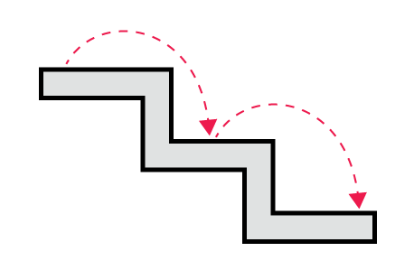
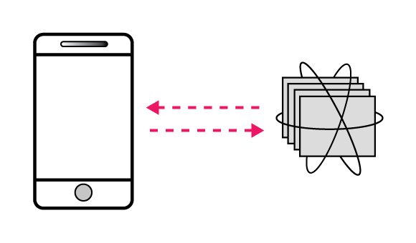
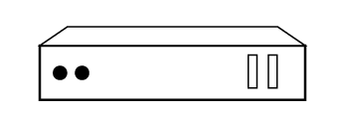
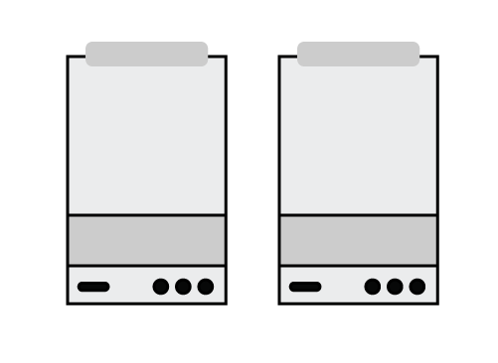
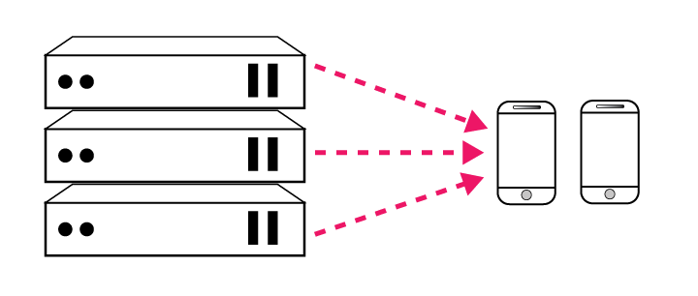
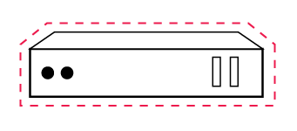
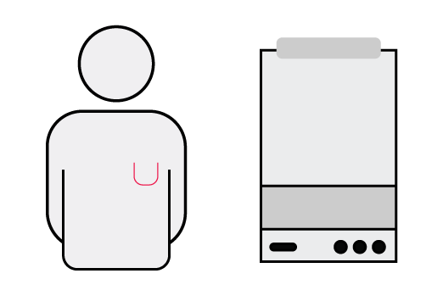
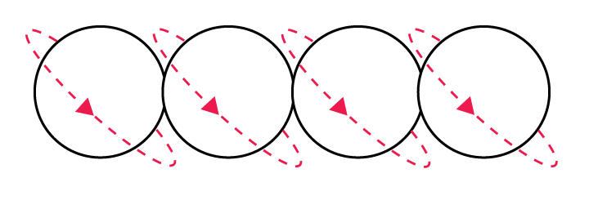
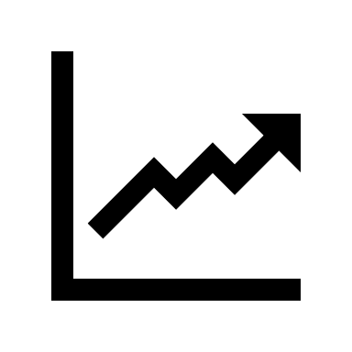
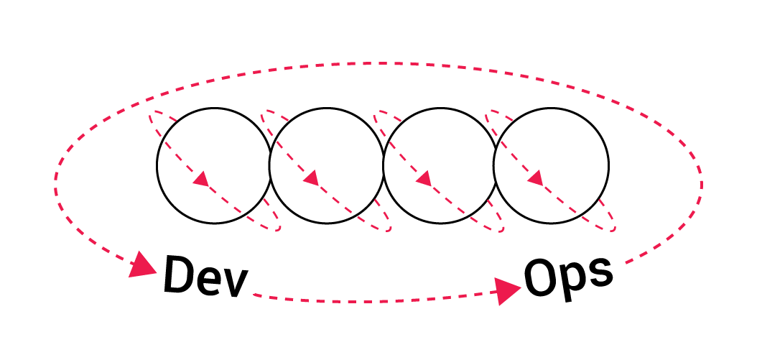
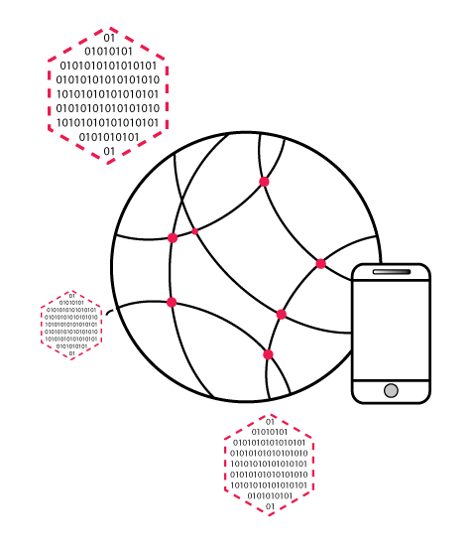
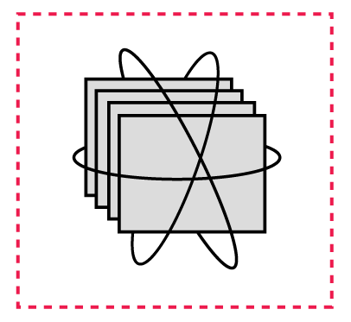
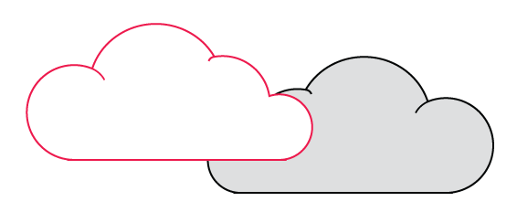

Technology & Culture Shift
End Users Experience
Development Process
Application Architecture
Deployment and Packaging
Application Infrastructure
Waterfall
Monolithic
Physical Servers
Datacenter
Security Governance
Agile
N-Tier
Virtual Servers
Hosted
Consumption Based Price
DevOps
Microservices
Containers
Cloud
Most Important
85% Multi Cloud (Hybrid) Adoption
Agility Flexibility
© 2018 SYNECTIKS. All Rights Reserved. Proprietary and Confidential.

Slide 3
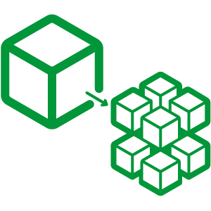
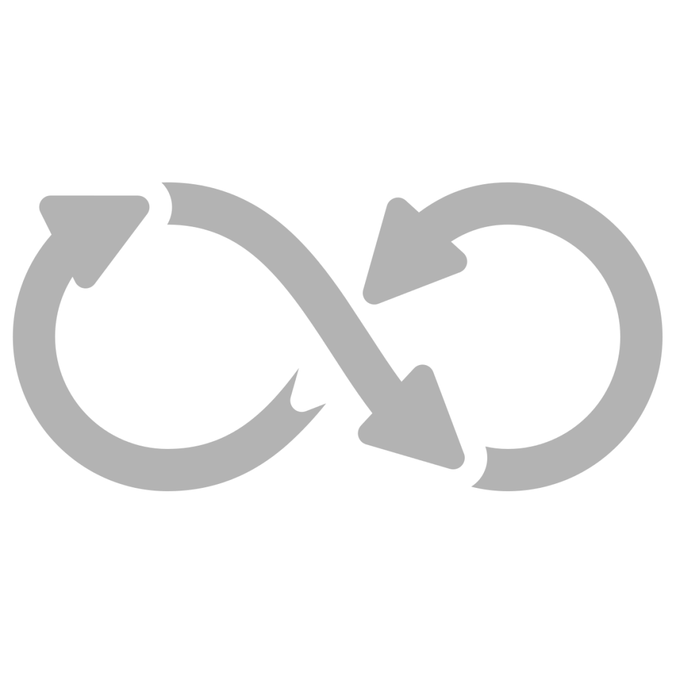
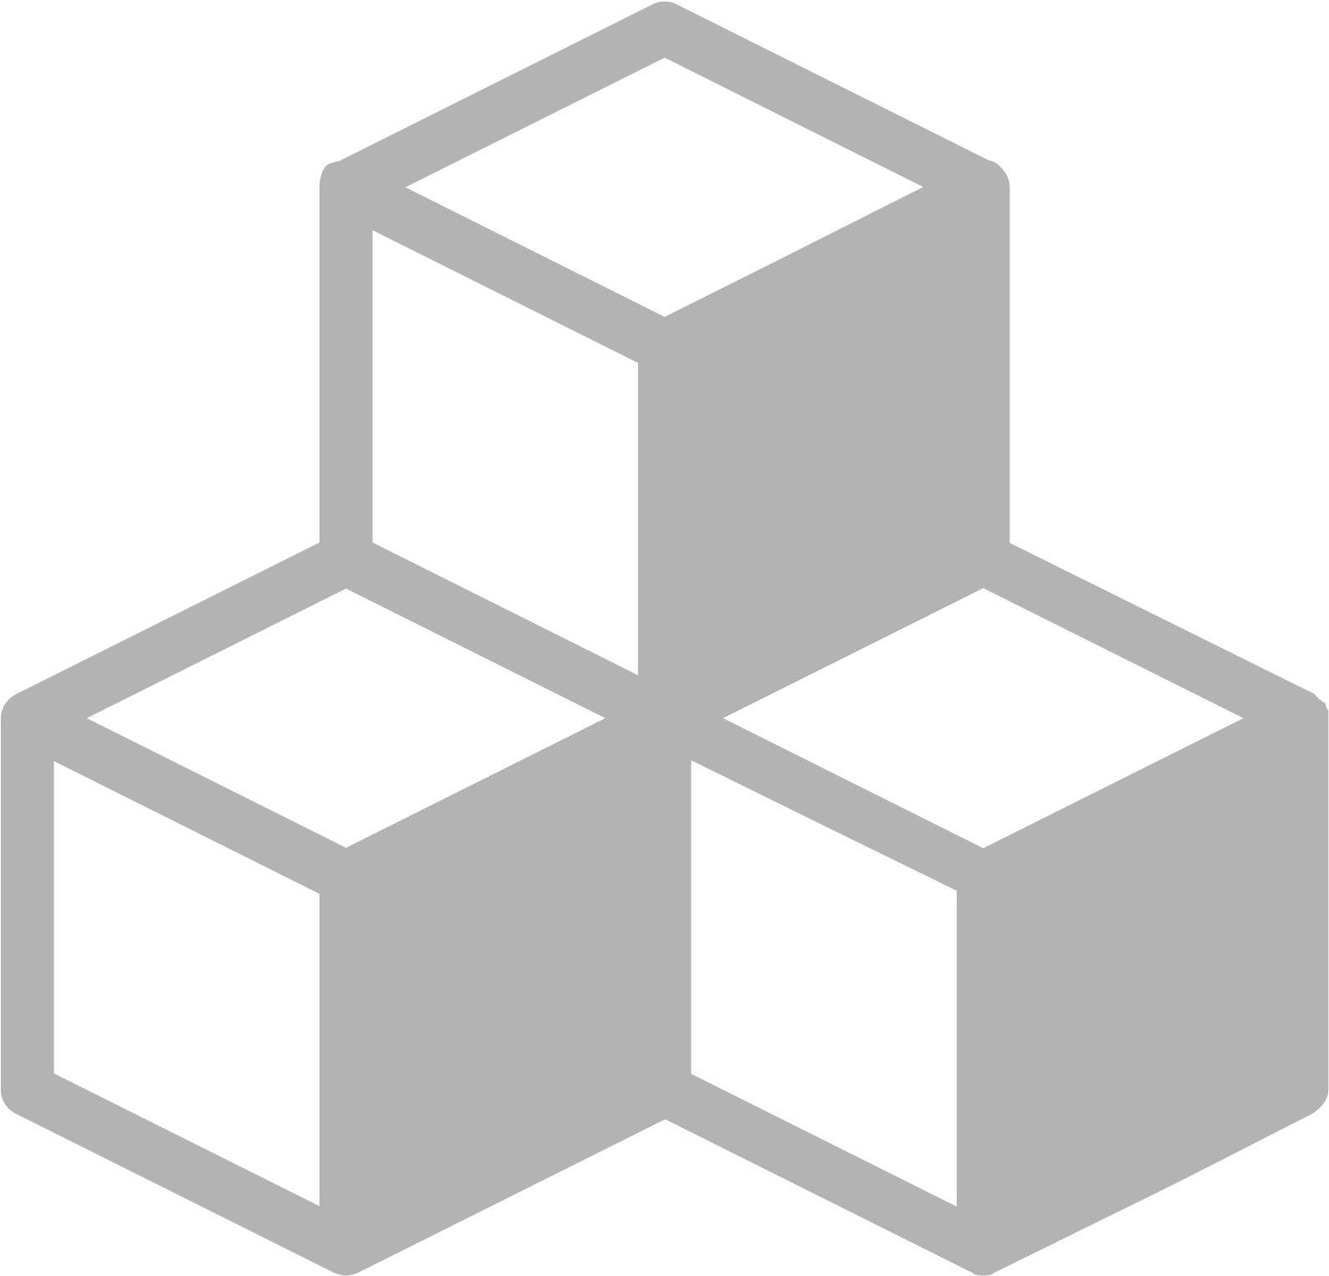

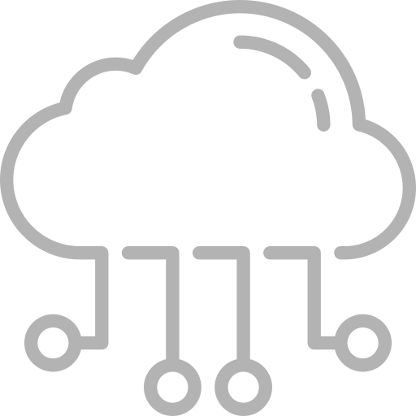

Expertise
DELIVERING PURPOSE-BUILT SOLUTIONS BASED ON OPEN PRODUCTS AND FRAMEWORK
01/ Microservices
Modernizing traditional application and legacy infrastructure.
01
02/ DevOps
Empowering Organization to adopt DevOps culture with through specialized people, tools and training.
06
02
06/ RAD
Rapidly build App Blocks based business application in predictable and deterministic way.
01
03/ Cloud
Accelerating cloud adoption and software defined transformation through open tools and frameworks.
05
04
03
04
03
04/ Monitoring
Develop purpose-built monitoring solutions based on proven open frameworks.
05/ Analytics
Develop purpose-built Fast Data and Big Data solutions based on proven open frameworks.
© 2018 SYNECTIKS. All Rights Reserved. Proprietary and Confidential.

Slide 4
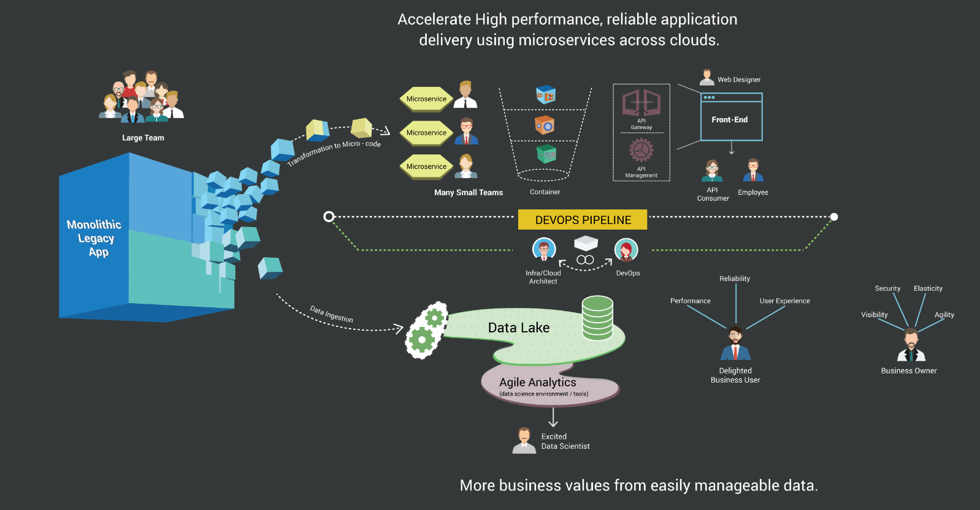

Microservices Xformation
  Activities
  Refactor
  DevOps Workflow
  Continuous Delivery
  Continuous Monitoring
  Continuous Security
  Continuous Compliance
  Continuous Operation Automation
  Why Us?
  Large Transformation Experience
  Existing Codebase reduce 50% time & Effort
  Minimal Code change Approach
  E2E complete cycle delivery (refactor , DevOps Workflow, Automation)
  Availability of Specialized resource Pool

Slide 5
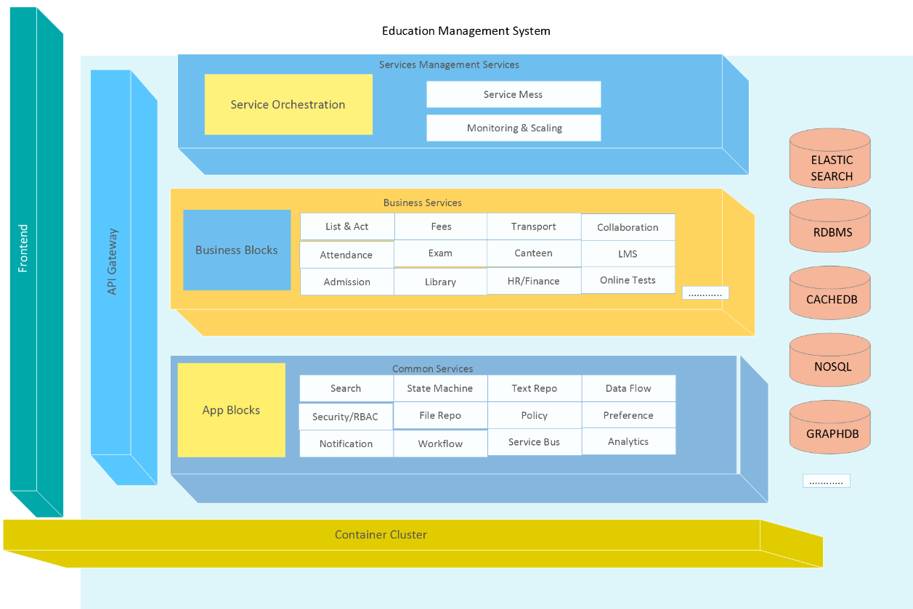
App Blocks Architecture
  Need
  All Apps have common services , why not build and maintain those fundamental blocks in Rock Solid way and develop different business Apps based on those services' API.
  Develop strong Business specific blocks in unified way.
  Increase developer productivity by having a unified dev process that is predictive & deterministic.
  Answer
  Reusable cloud agnostic App Blocks reducing refactoring effort @50%.
  A complete microservice driven standard example App to empower customer engineering team build microservices delivery practices rapidly.

Slide 6
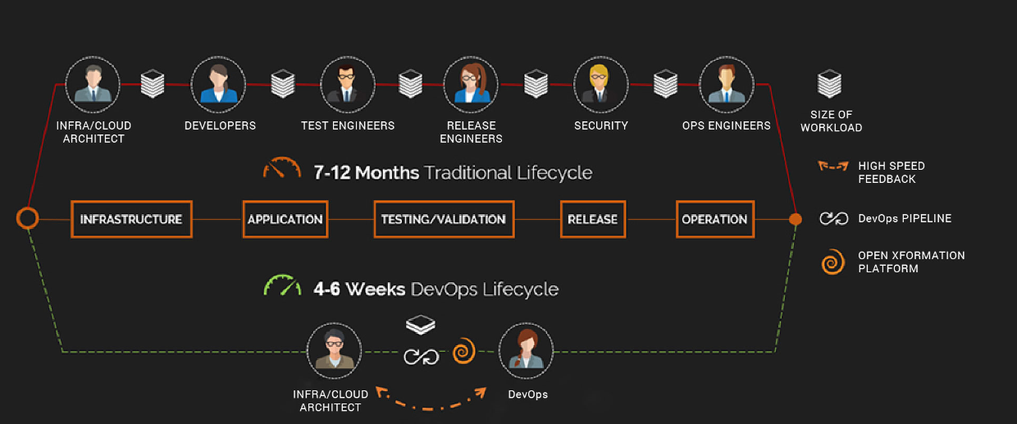
DevOps Xformation
  Need
  A culture with less Roles , much E2E responsibilities
  Innovate / Deliver Fast
  High Speed Feedback and Superfast Delivery
  Lower Capex, Opex
  Why Us?
  Experience in addressing Technology & Cultural Changes
  Accelerate DevOps adoption with Open Platform & Skilled resources.
  Assess DevOps maturity and address Gaps.

Slide 7
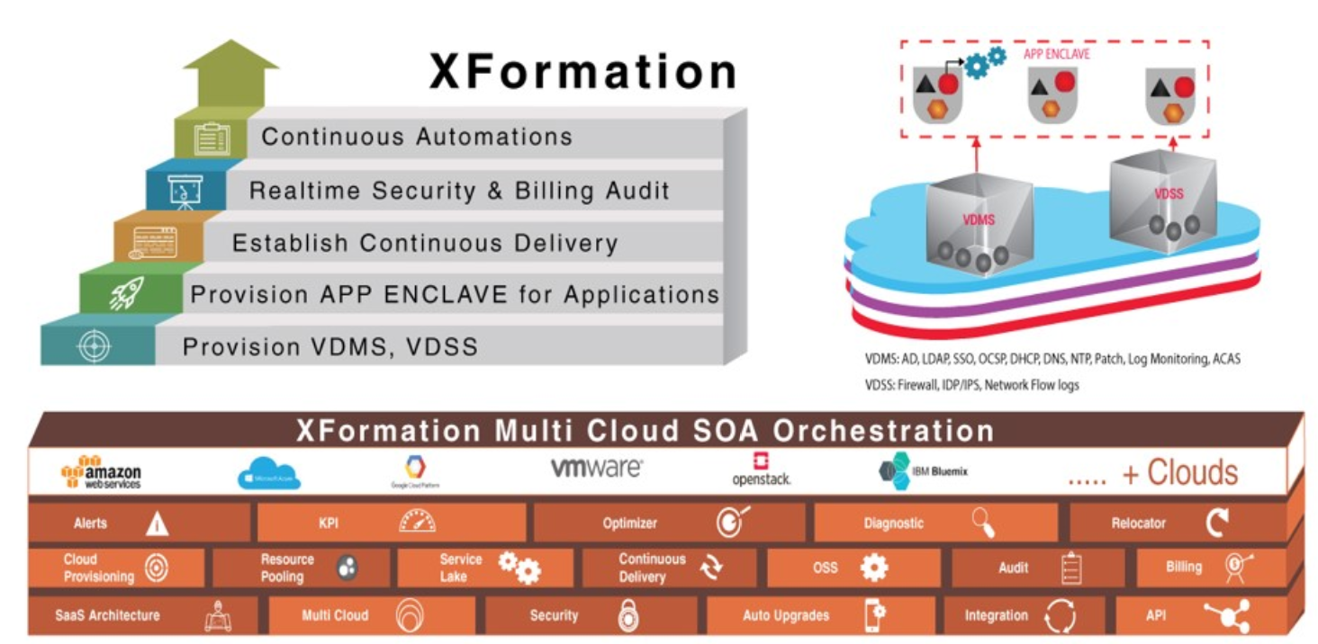
DevOps Tooling
  Need
  Reduce provisioning effort required to establish organization wise secure cloud adoption journey , like provisioning management and security backplane for multiple apps, create sperate application enclaves to deploy application services , developing DevOps workflows and having compliance and monitoring platform to manage through single pane.
  Answer
  Automated software defined provisioning to accelerate cloud adoption in secure way.
  Tools to manage multiple products and associated service through single control plane.
  Standardized continuous delivery, continuous compliance, continuous automation artifacts.

Slide 8
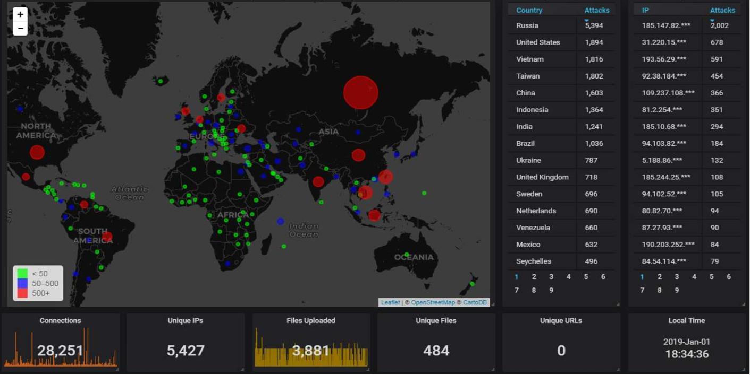
Monitoring Platform
  Need
  Every business monitoring requirement is unique, customers need a highly flexible platform so that they can build highly customizable purpose-built solutions at speed and lower economies.
  Why Us?
  Delivered purpose-built monitoring for large business.
  Build any custom solutions using proven framework.
  Buy capabilities , instead of any propitiatory closed product.
  A team able to collect and deliver business monitoring requirement at speed.

Slide 9
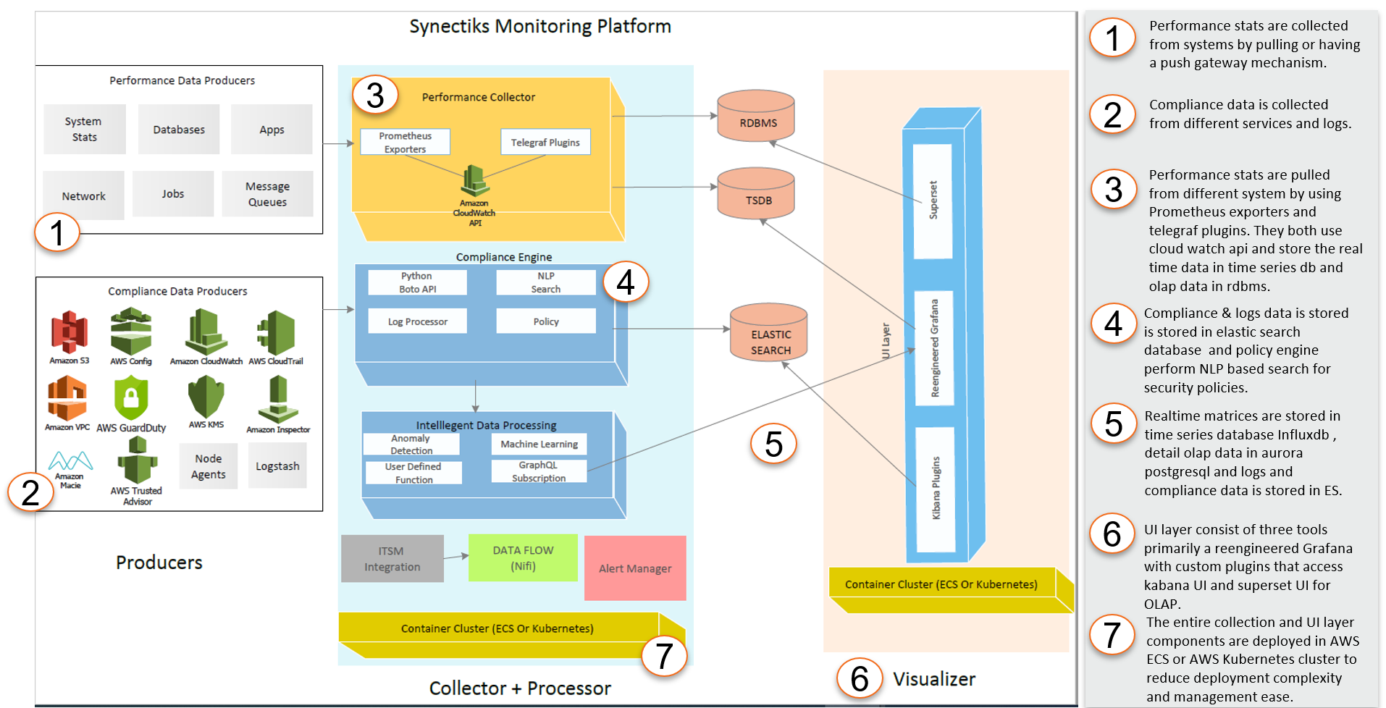
Platform Architecture
  Need
  Every business monitoring requirement is unique, customers need a highly flexible platform so that they can build highly customizable purpose-built solutions at speed and lower economies.
  Why Us?
  Delivered purpose-built monitoring for large business.
  Build any custom solutions using proven framework.
  Buy capabilities , not any propitiatory closed product.
  A team able to collect and deliver business monitoring requirement at speed.

Slide 10
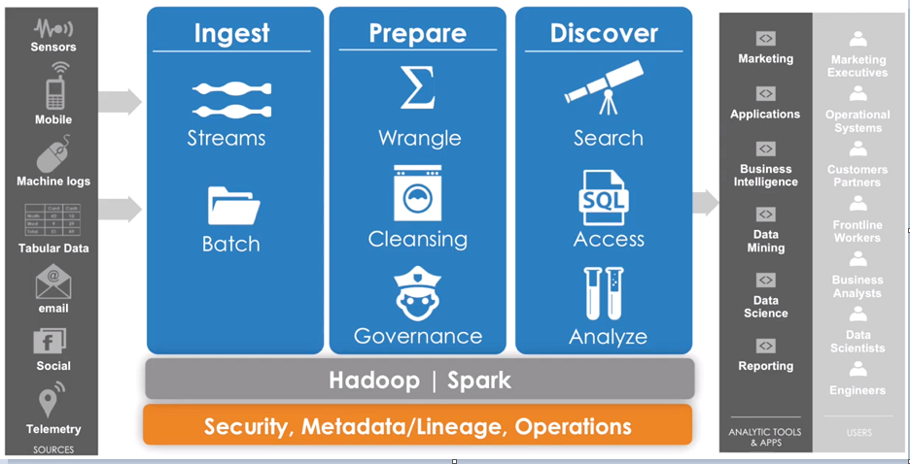
Analytic Platform
  Need
  Cloud native Fast-Data & Big-Data platform that serves as single source of truth for real -time , olap , relational data catering any data source (unstructured , semi- structured un-structured) .
  Why Us?
  Delivered purpose-built analytics for large business.
  Open framework to
  1) Automate Data Management & Query optimization
  2)Integrated Policy based alert & remediation
  3)NLP & Deep Learning Enabled
  -- Resource pool trained to
  Data Management
  Data Governance
  Smart Analytics

Slide 11
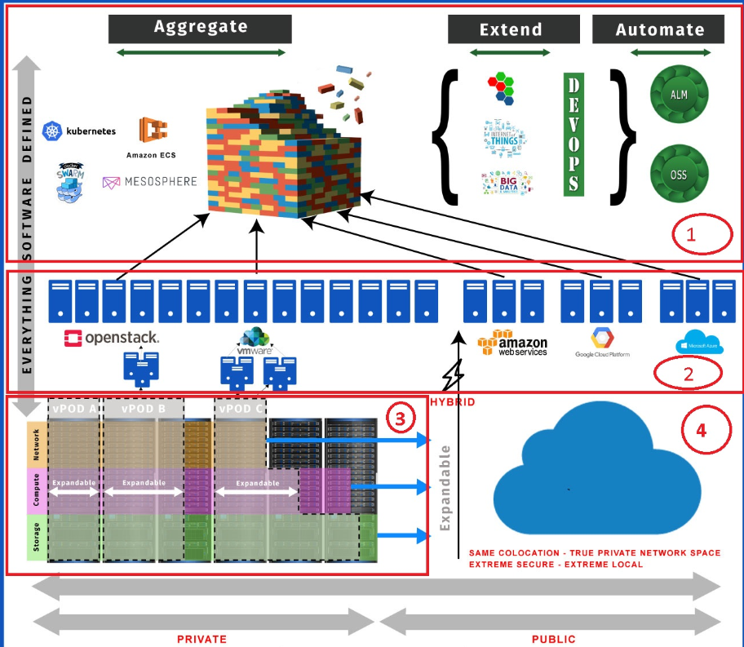
Cloud Automation
  Need
  Right Technology / People / Process to implement Hybrid IT strategy that scale across clouds and offers maximum security ,innovation speed at optimal economies .
  Why Us?
  Experience Team with proven track record of CloudOps delivery enabled with DevSecOps Capabilities.
  Our open Product Driven Delivery Model allows customers to quickly build, deliver and orchestrate cross cloud services @50% time & cost.
  Use our existing automation capabilities to automate infrastructure , operations, security in hybrid IT environment
  Our every engagement focused on empowerment – not dependency

